Slide 1


Movie Recommendation System
GROUP 30
PRERAK PANWAR
JAI SAXENA
Yi Hsiang Hung

Slide 2
AGENDA
INTRODUCTION
PROJECT FLOW
DATASET
DATA PREPROCESSING
MODEL EXPLANATION
WEBSITE (MODEL DEMO)

Slide 3
INTRODUCTION
End-to-End Project: Our project involves a complete process from start to finish. We've begun by selecting a movie database and then proceeded to build and train a model to function as a recommender system.
Recommender System Overview: A Recommender system is a form of machine learning that utilizes data to assist in predicting and narrowing down choices among a vast array of options. It's particularly helpful when faced with an overwhelming number of choices, such as scrolling through hundreds or thousands of movies.
Content-Based Recommendations: Our model focuses on content-based recommendations. By analyzing the movie content that users have been browsing or watching, it provides personalized suggestions, acting as a personal movie assistant. This tailored approach aims to keep users engaged by offering them relevant content, potentially leading to subscriptions to monthly or yearly plans.
Industry Influence and User Experience: Major online movie platforms like Netflix and Prime Video heavily rely on recommender systems to retain users and boost subscriptions. By tailoring recommendations, these platforms make it easier for users to discover content they love, thereby enhancing their movie-watching experience. Our model contributes to this e-commerce ecosystem by providing users with more options based on their viewing preferences, enriching their overall experience and encouraging return visits.

Slide 4
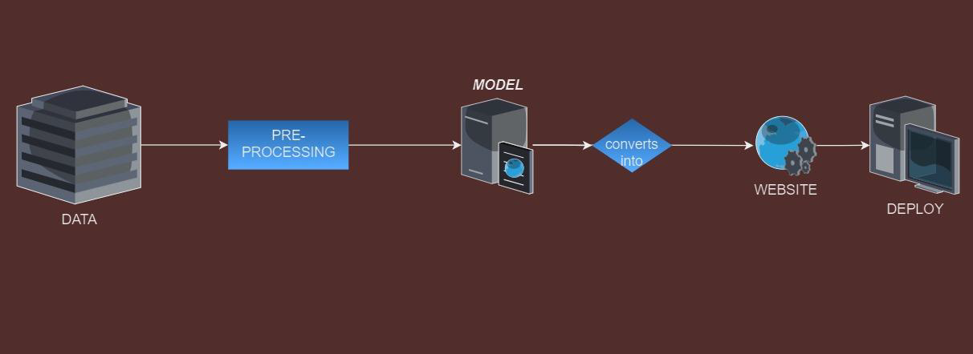
Project Flow
DATA → PREPROCESSING → CREATE A MODEL → TRAIN MODEL → MOVIE RECOMMENDER SYSTEM
DATASET: TMDB 5000 movie dataset from Kaggle

Slide 5
Data Preprocessing
A process of cleaning, transforming, and preparing the raw data before it is used for machine learning or analysis.
Cleaning:
Removing errors and inconsistencies from data.
Transforming:
Converting data into a usable format.

Slide 6
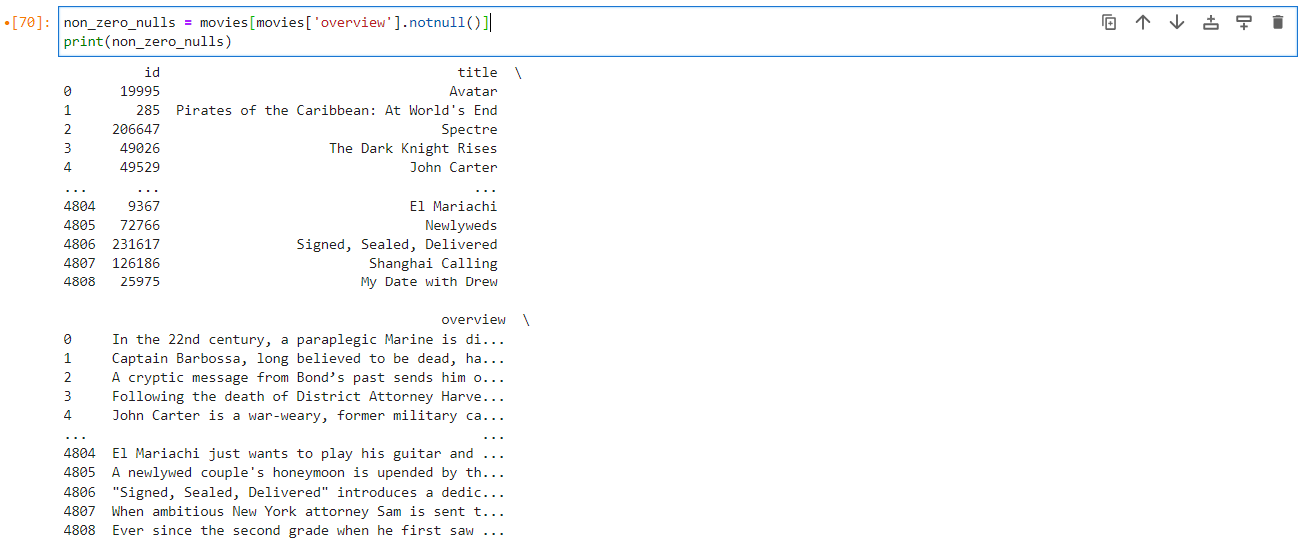
Data Preprocessing
Data Cleaning

Slide 7
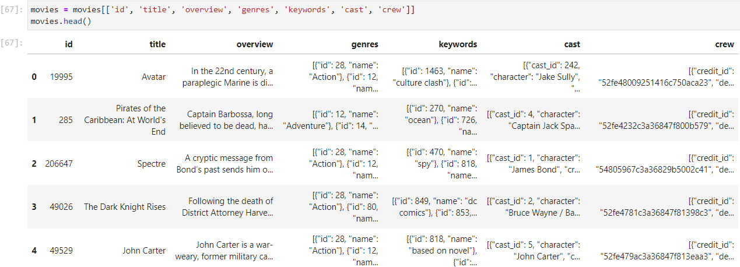
Data Preprocessing
Data Transforming

Slide 8
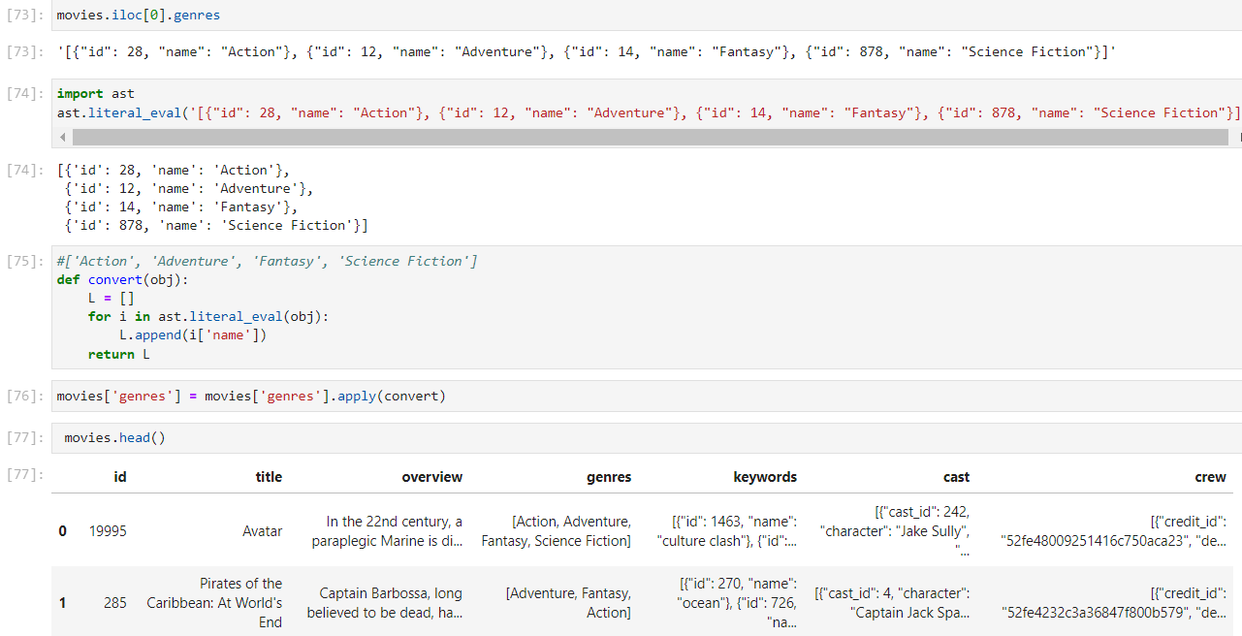
Data Preprocessing
Data Transforming

Slide 9
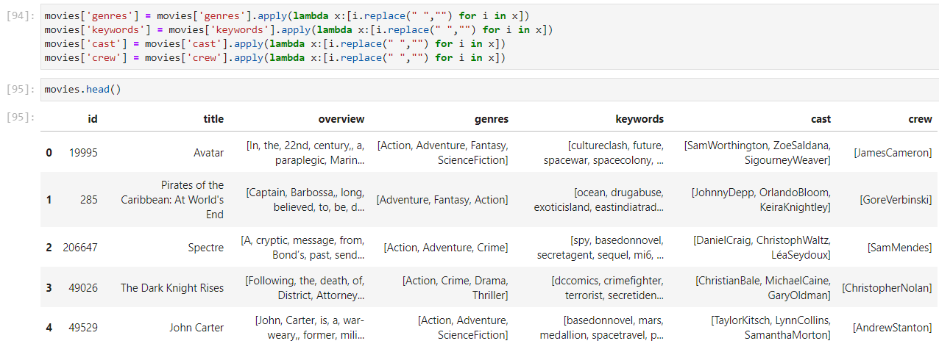
Data Preprocessing
Data Transforming

Slide 10
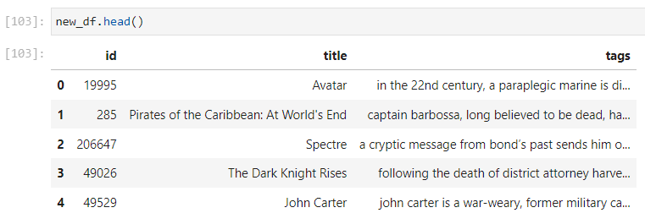
Data Preprocessing

Slide 11
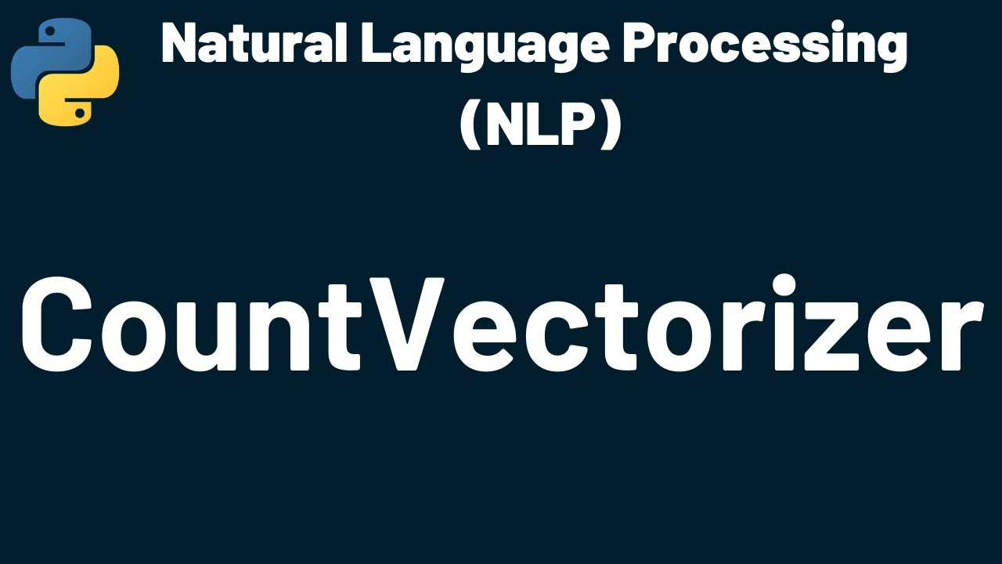
Text Vectorization:
Text Vectorization: Text vectorization is the process of converting text data into numerical vectors that machine learning algorithms can understand. It's a crucial step in natural language processing (NLP) tasks where textual data needs to be transformed into a format suitable for mathematical analysis and modeling.
Bag of Words (BoW):
Represents text as a collection of words, disregarding grammar and word order.
Each document is represented by a vector where each element corresponds to the frequency of a word in the vocabulary.
Widely used for text classification, sentiment analysis, and document similarity tasks.
TF-IDF:
Measures word importance by considering frequency in a document and rarity across the corpus.
Emphasizes words specific to a document while downplaying common words.
Word Embeddings:
Maps words to dense vectors capturing semantic relationships.
Represents words in a continuous vector space for NLP tasks like sentiment analysis and language understanding.

Slide 12

Stemming:
Stemming is like simplifying words down to their basic form, called the "stem." It chops off the ends of words to get to the root or base form. For example, if you have words like "running," "ran," and "runs," stemming will reduce them all to "run."
Here’s a simple example:
Original Words: running, ran, runs
Stemmed Words: run, run, run
Stemming is handy because it reduces different forms of the same word to a common base, which can help in tasks like text analysis, where you want to treat similar words the same way.

Slide 13
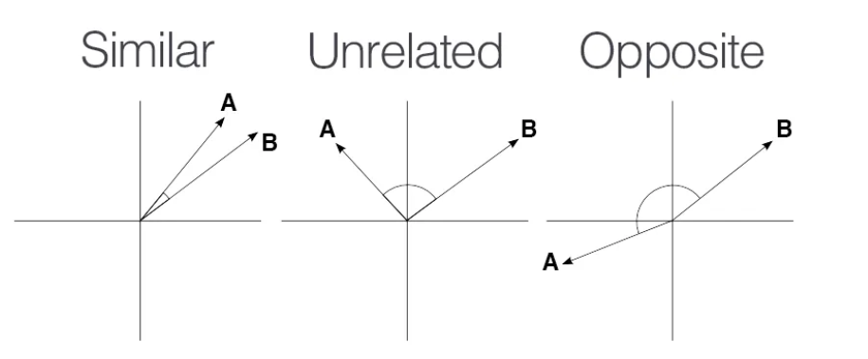
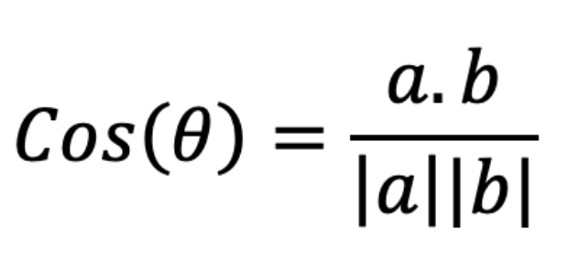
Cosine Distance:
The cosine distance formula measures the similarity between two vectors by calculating the cosine of the angle between them. It's commonly used in various fields such as text analysis, recommendation systems, and image processing.

Slide 14


Website Creation:
Pickle and .pkl files:
1-Serialization: Pickle serializes Python objects into .pkl files for storage or transmission.
2-Usage: Commonly used for saving/loading machine learning models and complex data structures.
3-File Format: When you save an object using Pickle, it creates a binary file with the .pkl
extension, which contains the serialized data of the object.
Streamlit:
1-Web Apps: Streamlit creates interactive web apps directly from Python scripts.
2-Simplicity: Easy web app development without needing HTML/CSS/JS knowledge.
3-Widgets: Provides widgets for interactive elements like sliders, buttons, and plots.
4-Deployment: Apps can be deployed locally, on cloud services, or via Streamlit Sharing.

Slide 15

Questions?

